Slide 1

Introduction to AI Problem Solving and State Space Search SY B.Sc. (CS)
Semester IV
Poornima .N
Assistant Professor, Department of IT/CS
1

Slide 2

2 Topics:
Introduction to Problem-Solving Agents
Formulating Problems
State Space Representation.
Problem as a State Space Search
Well-Defined Problem
“How does a GPS find the shortest path among thousands of routes?”

Slide 3
Introduction to Problem-Solving Agents

Slide 4

3 What is a Goal-Based Agent?
A goal-based agent is an intelligent agent that acts to achieve a goal.
It selects actions by considering future consequences, not just reacting immediately.
The agent checks whether a given state will help achieve the goal before choosing an action.

Slide 5
3 Example: Goal-Based Agent?
A person in a city wants to reach the airport. The goal helps them decide which path to take

Slide 6
3 What is a Problem-Solving Agent?
A problem-solving agent is an intelligent agent that makes decisions by searching through possible actions and selecting a sequence that achieves the goal.

Slide 7
4 Example
🧠 Google Maps deciding the best route
It evaluates multiple paths (states)
Searches which route is shortest or fastest
Selects the optimal solution

Slide 8
4 How Problem Solving Works?
1. Goal Formulation
Based on current situation and performance measure.
2. Problem Formulation
Decide which actions and states to consider.

Slide 9
4 Well-defined problems and solutions
A solution to a problem is an action sequence that leads from the initial state to a goal state. Solution quality is measured by the OPTIMAL SOLUTION path cost function, and an optimal solution has the lowest path cost among all solutions.

Slide 10
6 A problem can be defined formally by five components:
Component | Meaning
Initial State | Where the agent begins
Actions / Operators | Possible choices available
Transition Model | What happens after performing an action
Goal Test | How to check if the goal is reached
Path Cost | Cost of solution path (e.g., distance, time)

Slide 11
7 Example
📍 Finding route from Mumbai to Goa
Initial state → Mumbai
Goal state → Goa
Actions → Drive via different highways
Test → Have we reached Goa?
Path cost → Distance / time / toll cost

Slide 12
7 Example: Agent Starting from Arad
From Arad, the agent has 3 possible actions:
Go(Sibiu)
Go(Timisoara)
Go(Zerind)
None of these immediately reach Bucharest.
If the agent doesn’t know geography, it must select randomly.
If it has a map, it can search for a path:
Arad → Sibiu → … → Bucharest (solution path)

Slide 13
7 Example: Agent Starting from Arad
Initial State: In(Arad)
Goal State: In(Bucharest)
Actions: Go(city)
Transition Model: Result(In(city1), Go(city2)) = In(city2)
Path Cost: Sum of distances

Slide 14
7 Example: Agent Starting from Arad
Initial State: In(Arad)
Goal State: In(Bucharest)
Possible actions from Arad:
Go(Sibiu), Go(Zerind), Go(Timisoara)
Transition Model example:
Result(In(Arad), Go(Zerind)) = In(Zerind)
Path Cost example:
Arad → Zerind = 75

Slide 15
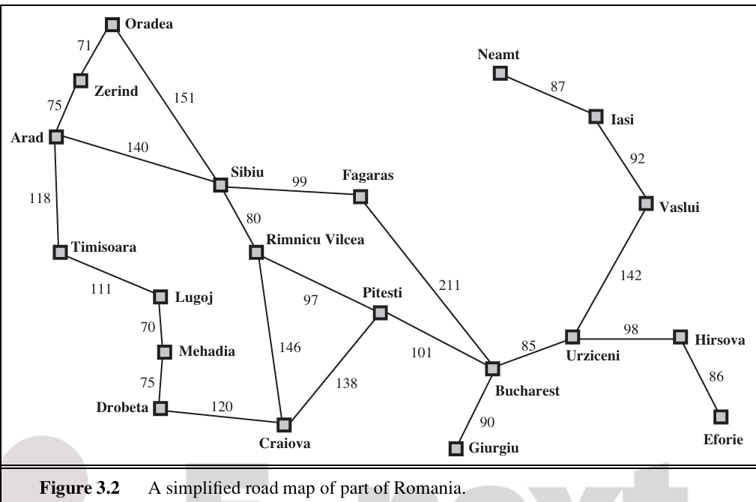

Slide 16
Activity
Example 1: Ordering food online
Example 2: Reaching college from home
Component | Answer
Initial State | __________
Goal State | __________
Actions | __________
Transition Model | __________
Path Cost | __________

Slide 17
Formulating Problems

Slide 18
5 What is Problem Formulation?
Problem formulation is the process of defining a problem so that it can be solved by an AI problem-solving agent.
It converts a real-world problem into a structure the agent can understand through:
States
Actions
Goals
Path costs

Slide 19
State Space Representation

Slide 20
8 What is State Space?
State space is the set of all possible states in which a problem can exist. It represents every possible configuration the agent may encounter while trying to reach the goal.

Slide 21
9 State Space Representation Includes
States → Different situations or configurations
Initial State → Where the agent starts
Goal State → Desired final condition
Actions → Steps to move between states
Transition Model → Rules that describe results of actions

Slide 22
10 Real-Life Example
🧠 Vacuum Cleaner Agent
States → Dirt on left, dirt on right, clean, etc.
Actions → Move left / Move right / Suck
Goal → Both rooms clean

Slide 23
11 What is State Space Search?
State space search is the process of exploring all possible states to find a sequence of actions that leads from the initial state to the goal state.

Slide 24
12 Types of Search
Uninformed (Blind) Search
No knowledge of goal distance
Examples: BFS, DFS, Uniform-cost
Informed (Heuristic) Search
Uses knowledge to estimate distance to goal
Examples: A*, Greedy Best-First Search

Slide 25
12 What is abstraction?
The process of removing irrelevant details from the problem representation while keeping enough information to solve the problem correctly.

Slide 26
12 Example:
Full real-world state: "I am in Arad, driving with friends, it’s raining, song playing is Tamally Maak , fuel is 50%, car speed 60km/h…"
Abstracted state: "I am in Arad"
We ignore everything except location, because that’s what matters for finding a route.

Slide 27
12 Toy vs Real-World Problems in AI
Toy Problem: Simplified, fully defined, used to test algorithms
Real-World Problem: Complex, messy, solutions matter to people

Slide 28
12 Example Toy Problem: The Vacuum World
Environment: 2 rooms
Agent: Robot vacuum
Goal: Clean all rooms
Actions:
L = Move Left
R = Move Right
S = Suck Dirt

Slide 29
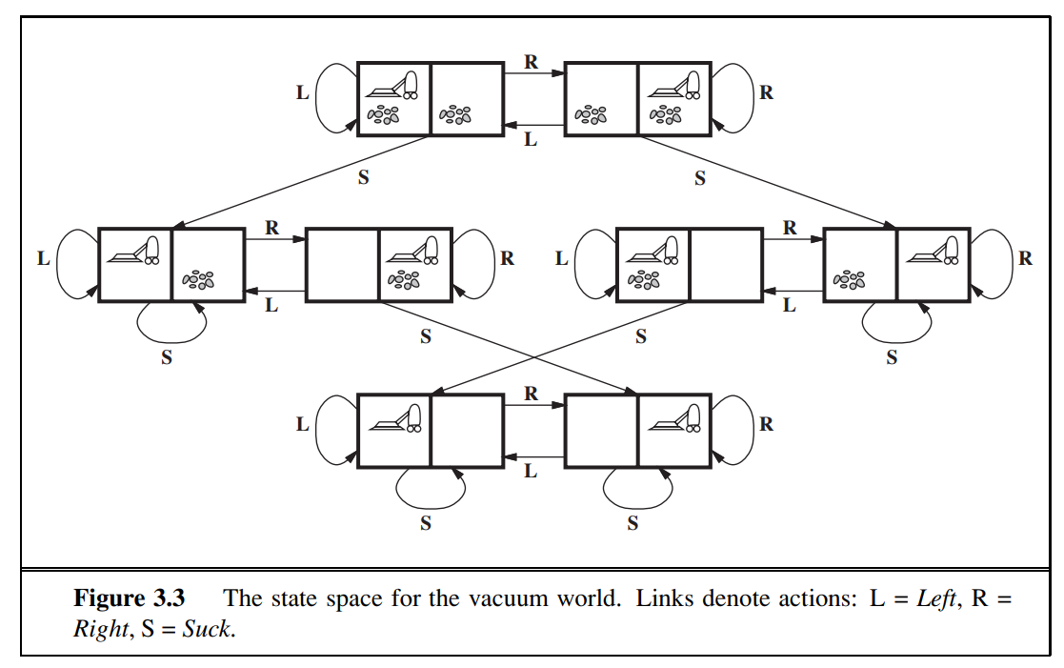

Slide 30
12 Example Toy Problem: The 8-Puzzle
A 3 × 3 sliding puzzle with 8 numbered tiles and 1 blank space
Objective: Reach the goal arrangement by sliding tiles into the blank position
Used in AI to test search algorithms

Slide 31
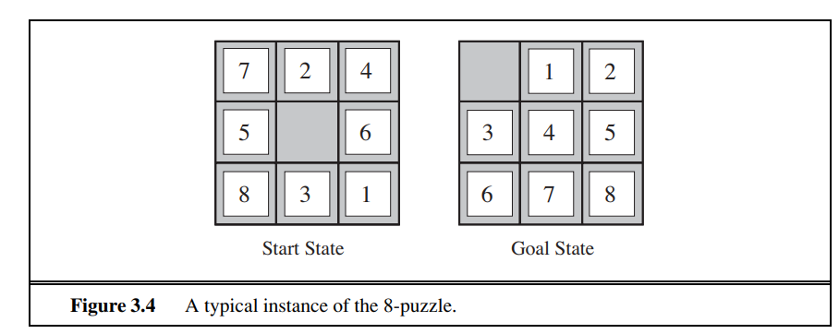

Slide 32
12 Example Toy Problem: 8-Queens Problem
Place 8 queens on an 8×8 chessboard in such a way that:
No two queens are in the same row
No two queens are in the same column
No two queens are on the same diagonal

Slide 33
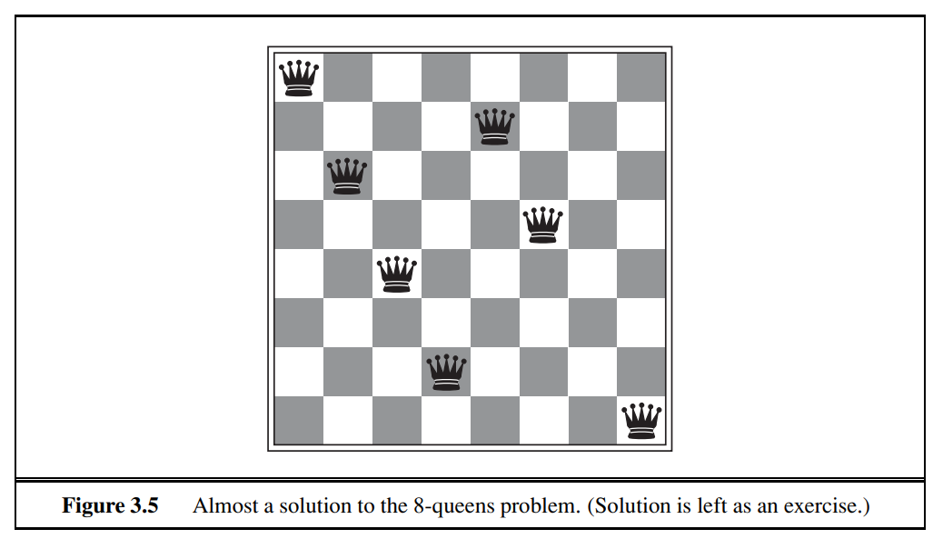

Slide 34
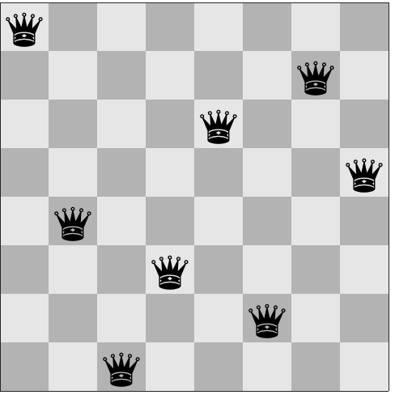

Slide 35
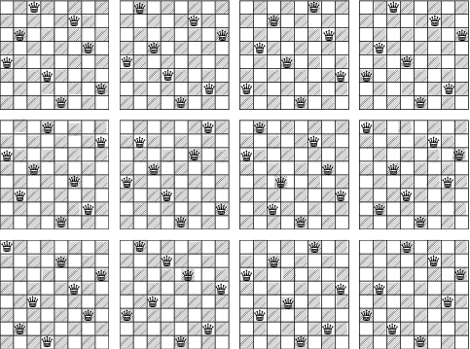

Slide 36
12 Donald Knuth
“Donald Knuth came up with a toy problem to show how some problems can have an infinite number of possible states. The idea: start with the number 4, and use three operations: 1️⃣ Factorial (!) 2️⃣ Square root (√) 3️⃣ Floor (round down ⌊x⌋) The goal is to reach any positive number you want.”

Slide 37

12 Example: Donald Knuth
Start with:
$$n=24!=620,448,401,733,239,439,360,000$$
1st sqrt: $\sqrt{n}≈2.49×{10}^{11}$
2nd sqrt: $\sqrt{2.49×{10}^{11}}≈499,000$
3rd sqrt: $\sqrt{499,000}≈706.4$
4th sqrt: $\sqrt{706.4}≈26.6$
5th sqrt: $\sqrt{26.6}≈5.16$
✅ Now take floor:
$$\left\lfloor 5.16\right\rfloor =5$$

Slide 38
12 Example Real Problem: Route-finding Problem
States: Location + time + flight info
Actions: Take any valid flight
Goal: Reach destination efficiently

Slide 39
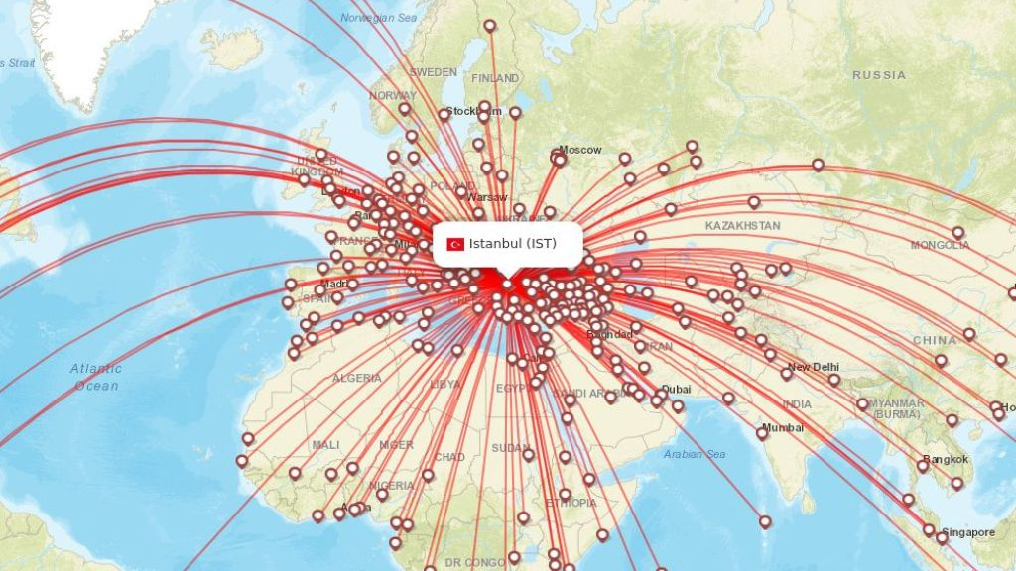

Slide 40
12 Example Real Problem: Touring Problem
Visit all cities (each once for TSP)
State: Current city + visited cities
Goal: Shortest tour covering all cities

Slide 41
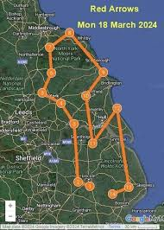

Slide 42
12 Example Real Problem: VLSI Layout Problem
Place chip components and wires efficiently
Goal: Minimize area, delays; maximize yield

Slide 43



Slide 44
12 Example Real Problem: Robot Navigation
Continuous space → infinite states
Must handle sensor/motor errors
Goal: Reach target position safely

Slide 45
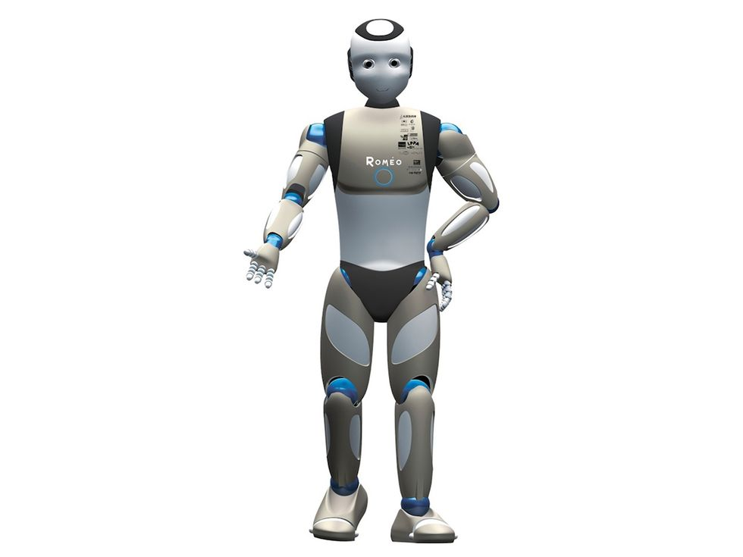

Slide 46
12 Example Real Problem: Assembly Sequencing
Correct order of part assembly
Wrong order → impossible to continue
Goal: Complete assembly

Slide 47
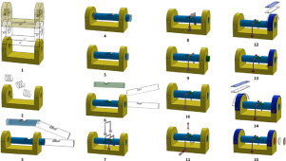

Slide 48
12 Example Real Problem: Protein Design
Find amino acid sequence that folds correctly
Goal: Desired 3D structure
Think of a chain of beads joined together.
Each joint can bend Left / Right / Straight.
Many possible folding shapes → huge search space.
Computers can’t try all possibilities.
So, it becomes an NP-Hard problem.

Slide 49
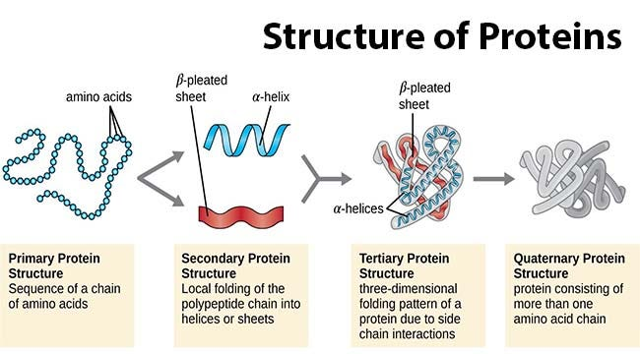

Slide 50


Slide 51
12 Classification of Problems
P – Solvable efficiently (Shortest Path)
NP – Hard to solve, easy to verify (8 Queens, Sudoku)
NP-Complete – Hardest NP problems (TSP)
NP-Hard – Harder than NP-Complete (Scheduling)
Undecidable – No algorithm can solve (Halting)

Slide 52

12 Classification of Problems
Each joint can turn in 3 possible directions:
Left
Right
Straight
If your chain has 4 beads:
Total possibilities =
$$3^{4}=81combinations$$
If your chain has 100 beads:
$$3^{100}=anumberbiggerthanstarsintheuniverse\text{😭}$$
So a computer would take years or centuries to try all possibilities.

Slide 53
16 1. Problem:
A problem in AI is a task or situation that requires a solution. It can be any real-world scenario where an agent needs to achieve a specific goal starting from an initial condition, following certain rules or constraints.
Example: Finding the shortest route from Arad to Bucharest.

Slide 54
16 2. State:
A state represents a snapshot of the environment or situation at a given moment. It contains all the information needed to describe the current condition of the problem.
Example: At a given point in the journey, the agent is at city Arad. The current city, fuel, or any other relevant info defines the state.

Slide 55
16 3. State-Space:
The state-space is the set of all possible states that can be reached from the initial state by performing all possible actions. It can be represented as a graph or tree where:
Nodes = states
Edges = actions leading from one state to another
Example: All cities connected by roads in Romania form the state-space for the route-finding problem.

Slide 56
16 4. Problem Formulation:
Problem formulation is the process of defining a problem in a structured way so that an AI agent can solve it. It involves specifying:
Initial state – where the agent starts
Actions – possible moves the agent can make
Goal state(s) – desired outcome(s)
Path costs – cost associated with moving between states

